Slide 1
Cryptography and Network Security Chapter 10
Key Management
Other Public Key Cryptosystems
Notes:
Lecture slides by Lawrie Brown for “Cryptography and Network Security”, 4/e, by William Stallings, Chapter 10 – “Key Management; Other Public Key Cryptosystems”.

Slide 2
Key Management
public-key encryption helps address key distribution problems
have two aspects of this:
distribution of public keys
use of public-key encryption to distribute secret keys
Notes:
One of the major roles of public-key encryption has been to address the problem of key distribution, with two distinct aspects: the distribution of public keys, and the use of public-key encryption to distribute secret keys.

Slide 3
Distribution of Public Keys
can be considered as using one of:
public announcement
publicly available directory
public-key authority
public-key certificates
Notes:
Several techniques have been proposed for the distribution of public keys, which can mostly be grouped into the categories shown.

Slide 4
Public Announcement
users distribute public keys to recipients or broadcast to community at large
eg. append PGP keys to email messages or post to news groups or email list
major weakness is forgery
anyone can create a key claiming to be someone else and broadcast it
until forgery is discovered can masquerade as claimed user
Notes:
The point of public-key encryption is that the public key is public, hence any participant can send his or her public key to any other participant, or broadcast the key to the community at large. Its major weakness is forgery, anyone can create a key claiming to be someone else and broadcast it, and until the forgery is discovered they can masquerade as the claimed user.

Slide 5
Publicly Available Directory
can obtain greater security by registering keys with a public directory
directory must be trusted with properties:
contains {name,public-key} entries
participants register securely with directory
participants can replace key at any time
directory is periodically published
directory can be accessed electronically
still vulnerable to tampering or forgery
Notes:
A greater degree of security can be achieved by maintaining a publicly available dynamic directory of public keys. Maintenance and distribution of the public directory would have to be the responsibility of some trusted entity or organization. This scheme is clearly more secure than individual public announcements but still has vulnerabilities to tampering or forgery.

Slide 6
Public-Key Authority
improve security by tightening control over distribution of keys from directory
has properties of directory
and requires users to know public key for the directory
then users interact with directory to obtain any desired public key securely
does require real-time access to directory when keys are needed
Notes:
Stronger security for public-key distribution can be achieved by providing tighter control over the distribution of public keys from the directory. It requires users to know the public key for the directory, and that they interact with directory in real-time to obtain any desired public key securely. Note that a total of seven messages are required, as shown next.

Slide 7
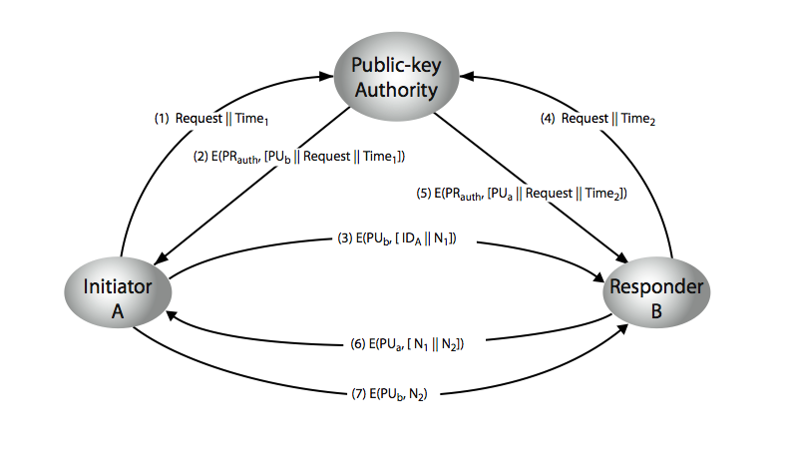
Public-Key Authority
Notes:
Stallings Figure 10.3 “Public-Key Authority” illustrates a typical protocol interaction. See text for details of steps in protocol.

Slide 8
Public-Key Certificates
certificates allow key exchange without real-time access to public-key authority
a certificate binds identity to public key
usually with other info such as period of validity, rights of use etc
with all contents signed by a trusted Public-Key or Certificate Authority (CA)
can be verified by anyone who knows the public-key authorities public-key
Notes:
An further improvement is to use certificates, which can be used to exchange keys without contacting a public-key authority, in a way that is as reliable as if the keys were obtained directly from a public-key authority. A certificate binds an identity to public key, with all contents signed by a trusted Public-Key or Certificate Authority (CA). This can be verified by anyone who knows the public-key authorities public-key.
One scheme has become universally accepted for formatting public-key certificates: the X.509 standard. X.509 certificates are used in most network security applications, including IP security, secure sockets layer (SSL), secure electronic transactions (SET), and S/MIME. Will discuss it in much more detail later.

Slide 9
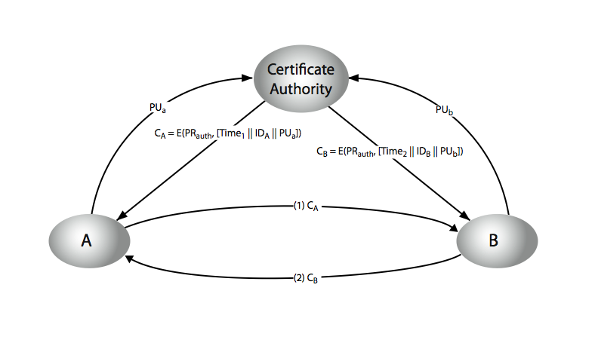
Public-Key Certificates
Notes:
Stallings Figure 10.4 “Public-Key Certificates” illustrates such a scheme. See text for details of steps in protocol.

Slide 10
Public-Key Distribution of Secret Keys
use previous methods to obtain public-key
can use for secrecy or authentication
but public-key algorithms are slow
so usually want to use private-key encryption to protect message contents
hence need a session key
have several alternatives for negotiating a suitable session
Notes:
Once public keys have been distributed or have become accessible, secure communication that thwarts eavesdropping, tampering, or both, is possible. However, few users will wish to make exclusive use of public-key encryption for communication because of the relatively slow data rates that can be achieved. Accordingly, public-key encryption provides for the distribution of secret keys to be used for conventional encryption.

Slide 11
Simple Secret Key Distribution
proposed by Merkle in 1979
A generates a new temporary public key pair
A sends B the public key and their identity
B generates a session key K sends it to A encrypted using the supplied public key
A decrypts the session key and both use
problem is that an opponent can intercept and impersonate both halves of protocol
Notes:
An extremely simple scheme was put forward by Merkle [MERK79]. But it is insecure against an adversary who can intercept messages and then either relay the intercepted message or substitute another message. Such an attack is known as a man-in-the-middle attack [RIVE84].

Slide 12
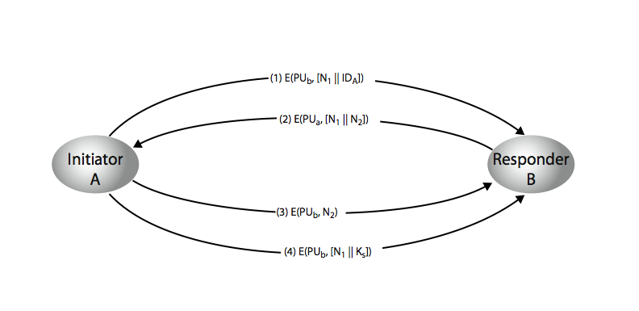
Public-Key Distribution of Secret Keys
if have securely exchanged public-keys:
Notes:
Stallings Figure 10.6 “Public-Key Distribution of Secret Keys” illustrates such an exchange. See text for details of steps in protocol. Note that these steps correspond to final 3 of Figure 10.3, hence can get both secret key exchange and authentication in a single protocol.

Slide 13
Hybrid Key Distribution
retain use of private-key KDC
shares secret master key with each user
distributes session key using master key
public-key used to distribute master keys
especially useful with widely distributed users
rationale
performance
backward compatibility
Notes:
Yet another way to use public-key encryption to distribute secret keys is a hybrid approach in use on IBM mainframes [LE93]. This scheme retains the use of a key distribution center (KDC) that shares a secret master key with each user and distributes secret session keys encrypted with the master key. A public key scheme is used to distribute the master keys. The addition of a public-key layer provides a secure, efficient means of distributing master keys. This is an advantage in a configuration in which a single KDC serves a widely distributed set of users.

Slide 14
Diffie-Hellman Key Exchange
first public-key type scheme proposed
by Diffie & Hellman in 1976 along with the exposition of public key concepts
note: now know that Williamson (UK CESG) secretly proposed the concept in 1970
is a practical method for public exchange of a secret key
used in a number of commercial products
Notes:
The idea of public key schemes, and the first practical scheme, which was for key distribution only, was published in 1977 by Diffie & Hellman. The concept had been previously described in a classified report in 1970 by Williamson (UK CESG) - and subsequently declassified in 1987, see [ELLI99].

Slide 15
Diffie-Hellman Key Exchange
a public-key distribution scheme
cannot be used to exchange an arbitrary message
rather it can establish a common key
known only to the two participants
value of key depends on the participants (and their private and public key information)
based on exponentiation in a finite (Galois) field (modulo a prime or a polynomial) - easy
security relies on the difficulty of computing discrete logarithms (similar to factoring) – hard
Notes:
The purpose of the algorithm is to enable two users to securely exchange a key that can then be used for subsequent encryption of messages. The algorithm itself is limited to the exchange of secret values, which depends on the value of the public/private keys of the participants. The Diffie-Hellman algorithm uses exponentiation in a finite (Galois) field (modulo a prime or a polynomial), and depends for its effectiveness on the difficulty of computing discrete logarithms.

Slide 16
Diffie-Hellman Setup
all users agree on global parameters:
large prime integer or polynomial q
a being a primitive root mod q
each user (eg. A) generates their key
chooses a secret key (number): x_{A} < q
compute their public key: y_{A} = a^{xA} mod q
each user makes public that key y_{A}
Notes:
In the Diffie-Hellman key exchange algorithm, there are two publicly known numbers: a prime number q and an integer a that is a primitive root of q. The prime q and primitive root a can be common to all using some instance of the D-H scheme. Note that the primitive root a is a number whose powers successively generate all the elements mod q. Users Alice and Bob choose random secrets x's, and then "protect" them using exponentiation to create their public y's. For an attacker monitoring the exchange of the y's to recover either of the x's, they'd need to solve the discrete logarithm problem, which is hard.

Slide 17
Diffie-Hellman Key Exchange
shared session key for users A & B is K_{AB}:
K_{AB} = a^{xA.xB} mod q
= y_{A}^{xB} mod q (which B can compute)
= y_{B}^{xA} mod q (which A can compute)
K_{AB} is used as session key in private-key encryption scheme between Alice and Bob
if Alice and Bob subsequently communicate, they will have the same key as before, unless they choose new public-keys
attacker needs an x, must solve discrete log
Notes:
The actual key exchange for either party consists of raising the others "public key' to power of their private key. The resulting number (or as much of as is necessary) is used as the key for a block cipher or other private key scheme. For an attacker to obtain the same value they need at least one of the secret numbers, which means solving a discrete log, which is computationally infeasible given large enough numbers. Note that if Alice and Bob subsequently communicate, they will have the same key as before, unless they choose new public-keys.

Slide 18
Diffie-Hellman Example
users Alice & Bob who wish to swap keys:
agree on prime q=353 and a=3
select random secret keys:
A chooses x_{A}=97, B chooses x_{B}=233
compute respective public keys:
y_{A}=3⁹⁷ mod 353 = 40 (Alice)
y_{B}=3²³³ mod 353 = 248 (Bob)
compute shared session key as:
K_{AB}= y_{B}^{xA} mod 353 = 248⁹⁷ = 160 (Alice)
K_{AB}= y_{A}^{xB} mod 353 = 40²³³ = 160 (Bob)
Notes:
Here is an example of Diffie-Hellman from the text.

Slide 19
Key Exchange Protocols
users could create random private/public D-H keys each time they communicate
users could create a known private/public D-H key and publish in a directory, then consulted and used to securely communicate with them
both of these are vulnerable to a meet-in-the-Middle Attack
authentication of the keys is needed
Notes:
Detail a couple of possible Key Exchange Protocols based on Diffie-Hellman. Note that these are vulnerable to a meet-in-the-Middle Attack, and that authentication of the keys is needed.

Slide 20
Message Authentication
message authentication is concerned with:
protecting the integrity of a message
validating identity of originator
non-repudiation of origin (dispute resolution)
will consider the security requirements
then three alternative functions used:
message encryption
message authentication code (MAC)
hash function
Notes:
Up untill now, have been concerned with protecting message content (ie secrecy) by encrypting the message. Will now consider how to protect message integrity (ie protection from modification), as well as confirming the identity of the sender. Generically this is the problem of message authentication, and in eCommerce applications is arguably more important than secrecy. Message Authentication is concerned with: protecting the integrity of a message, validating identity of originator, & non-repudiation of origin (dispute resolution). There are three types of functions that may be used to produce an authenticator: message encryption, message authentication code (MAC), or a hash function.

Slide 21
Security Requirements
disclosure
traffic analysis
masquerade
content modification
sequence modification
timing modification
source repudiation
destination repudiation
Notes:
In the context of communications across a network, the attacks listed above can be identified.
The first two requirements belong in the realm of message confidentiality, and are handled using the encryption techniques already discussed.
The remaining requirements belong in the realm of message authentication. At its core this addresses the issue of ensuring that a message comes from the alleged source and has not been altered. It may also address sequencing and timeliness. The use of a digital signature can also address issues of repudiation by the source.

Slide 22
Message Encryption
message encryption by itself also provides a measure of authentication
if symmetric encryption is used then:
receiver know sender must have created it
since only sender and receiver now key used
know content cannot of been altered
if message has suitable structure, redundancy or a checksum to detect any changes
Notes:
Message encryption by itself can provide a measure of authentication. Here, the ciphertext of the entire message serves as its authenticator, on the basis that only those who know the appropriate keys could have validly encrypted the message. This is provided you can recognize a valid message (ie if the message has suitable structure such as redundancy or a checksum to detect any changes).

Slide 23
Message Encryption
if public-key encryption is used:
encryption provides no confidence of sender
since anyone potentially knows public-key
however if
sender signs message using their private-key
then encrypts with recipients public key
have both secrecy and authentication
again need to recognize corrupted messages
but at cost of two public-key uses on message
Notes:
With public-key techniques, can get a digital signature which can only have been created by key owner. But at cost of two public-key operations at each end on message.

Slide 24
Message Authentication Code (MAC)
generated by an algorithm that creates a small fixed-sized block
depending on both message and some key
like encryption though need not be reversible
appended to message as a signature
receiver performs same computation on message and checks it matches the MAC
provides assurance that message is unaltered and comes from sender
Notes:
An alternative authentication technique involves the use of a secret key to generate a small fixed-size block of data, known as a cryptographic checksum or MAC that is appended to the message. This technique assumes that two communicating parties, say A and B, share a common secret key K. A MAC function is similar to encryption, except that the MAC algorithm need not be reversible, as it must for decryption.

Slide 25
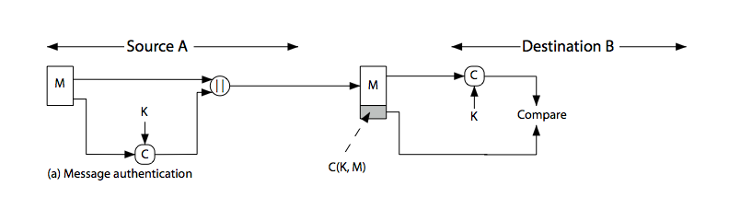
Message Authentication Code
Notes:
Stallings Figure 11.4a “Message Authentication” shows the use of a MAC just for authentication.

Slide 26
Message Authentication Codes
as shown the MAC provides authentication
can also use encryption for secrecy
generally use separate keys for each
can compute MAC either before or after encryption
is generally regarded as better done before
why use a MAC?
sometimes only authentication is needed
sometimes need authentication to persist longer than the encryption (eg. archival use)
note that a MAC is not a digital signature
Notes:
Can combine use of MAC with encryption in various ways to provide both authentication & secrecy.
Use MAC in circumstances where just authentication is needed (or needs to be kept), see text for examples.
A MAC is NOT a digital signature since both sender & receiver share key and could create it.

Slide 27
MAC Properties
a MAC is a cryptographic checksum
MAC = C_{K}(M)
condenses a variable-length message M
using a secret key K
to a fixed-sized authenticator
is a many-to-one function
potentially many messages have same MAC
but finding these needs to be very difficult
Notes:
A MAC, also known as a cryptographic checksum,is generated by a function C. The MAC is appended to the message at the source at a time when the message is assumed or known to be correct. The receiver authenticates that message by re-computing the MAC.
The MAC function is a many-to-one function, since potentially many arbitrarily long messages can be condensed to the same summary value, but don’t want finding them to be easy!

Slide 28
Requirements for MACs
taking into account the types of attacks
need the MAC to satisfy the following:
knowing a message and MAC, is infeasible to find another message with same MAC
MACs should be uniformly distributed
MAC should depend equally on all bits of the message
Notes:
In assessing the security of a MAC function, we need to consider the types of attacks that may be mounted against it. Hence it needs to satisfy the listed requirements.
The first requirement deals with message replacement attacks, in which an opponent is able to construct a new message to match a given MAC, even though the opponent does not know and does not learn the key.
The second requirement deals with the need to thwart a brute-force attack based on chosen plaintext.
The final requirement dictates that the authentication algorithm should not be weaker with respect to certain parts or bits of the message than others.

Slide 29
Using Symmetric Ciphers for MACs
can use any block cipher chaining mode and use final block as a MAC
Data Authentication Algorithm (DAA) is a widely used MAC based on DES-CBC
using IV=0 and zero-pad of final block
encrypt message using DES in CBC mode
and send just the final block as the MAC
or the leftmost M bits (16≤M≤64) of final block
but final MAC is now too small for security
Notes:
Can also use block cipher chaining modes to create a separate authenticator, by just sending the last block. This was done with the Data Authentication Algorithm (DAA), a widely used MAC based on DES-CBC (next slide). However this suffers from being too small for acceptable use today.

Slide 30
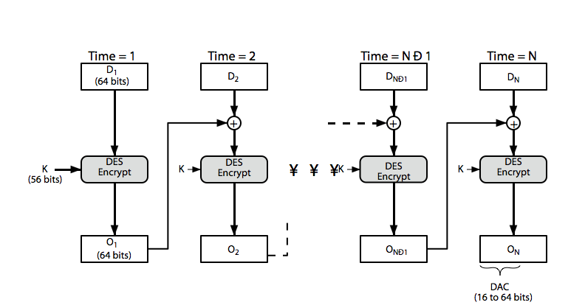
Data Authentication Algorithm
Notes:
Stallings Figure 11.6 “Data Authentication Algorithm”, illustrates the FIPS PUB 113 / ANSI X9.17 MAC based on DES-CBC with IV 0 and 0-pad of the final block if needed. Resulting MAC can be 16-64 bits of the final block. But this is now too small for security.

Slide 31
Hash Functions
condenses arbitrary message to fixed size
h = H(M)
usually assume that the hash function is public and not keyed
cf. MAC which is keyed
hash used to detect changes to message
can use in various ways with message
most often to create a digital signature
Notes:
A variation on the message authentication code is the one-way hash function. As with the message authentication code, a hash function accepts a variable-size message M as input and produces a fixed-size output, referred to as a hash code H(M). Unlike a MAC, a hash code does not use a key but is a function only of the input message. The hash code is also referred to as a message digest or hash value.

Slide 32
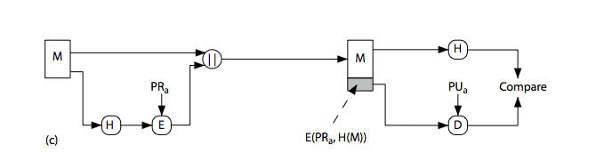
Hash Functions & Digital Signatures
Notes:
Stallings Figure 11.5c “Basic Uses of Hash Functions” shows the hash being “signed” with the senders private key, thus forming a digital signature.

Slide 33
Requirements for Hash Functions
can be applied to any sized message M
produces fixed-length output h
is easy to compute h=H(M) for any message M
given h is infeasible to find x s.t. H(x)=h
one-way property
given x is infeasible to find y s.t. H(y)=H(x)
weak collision resistance
is infeasible to find any x,y s.t. H(y)=H(x)
strong collision resistance
Notes:
The purpose of a hash function is to produce a “fingerprint”of a file, message, or other block of data.
These are the specifications for good hash functions. Essentially it must be extremely difficult to find 2 messages with the same hash, and the hash should not be related to the message in any obvious way (ie it should be a complex non-linear function of the message). There are quite a few similarities in the evolution of hash functions & block ciphers, and in the evolution of the design requirements on both.

Slide 34
Simple Hash Functions
are several proposals for simple functions
based on XOR of message blocks
not secure since can manipulate any message and either not change hash or change hash also
need a stronger cryptographic function (next chapter)
Notes:
All hash functions operate using the following general principles. The input (message, file,etc.) is viewed as a sequence of n-bit blocks, processed one block at a time in an iterative fashion to produce an n-bit hash function. Can construct a range of possible simple hash functions by just XOR’ing blocks with rotates etc. None of these are secure, since can predict how changes to message affect the resulting hash.

Slide 35
Birthday Attacks
might think a 64-bit hash is secure
but by Birthday Paradox is not
birthday attack works thus:
opponent generates 2^{m/2} variations of a valid message all with essentially the same meaning
opponent also generates 2^{m/2} variations of a desired fraudulent message
two sets of messages are compared to find pair with same hash (probability > 0.5 by birthday paradox)
have user sign the valid message, then substitute the forgery which will have a valid signature
conclusion is that need to use larger MAC/hash
Notes:
The Birthday Attack exploits the birthday paradox – the chance that in a group of people two will share the same birthday – only 23 people are needed for a Pr>0.5 of this. Can generalize the problem to one wanting a matching pair from any two sets, and show need 2^{m/2} in each to get a matching m-bit hash.
Note that creating many message variants is relatively easy, either by rewording or just varying the amount of white-space in the message. All of which indicates that larger MACs/Hashes are needed.

Slide 36
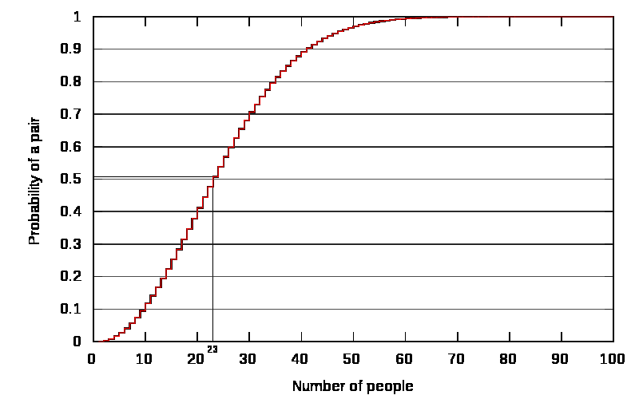
Birthday problem

Slide 37
Block Ciphers as Hash Functions
can use block ciphers as hash functions
using H₀=0 and zero-pad of final block
compute: H_{i} = E_{Mi} [H_{i-1}]
and use final block as the hash value
similar to CBC but without a key
resulting hash is too small (64-bit)
both due to direct birthday attack
and to “meet-in-the-middle” attack
other variants also susceptible to attack
Notes:
A number of proposals have been made for hash functions based on using a cipher block chaining technique, but without the secret key (instead using the message blocks as keys). Unfortunately these are subject to both the birthday attack, and to a “meet-in-the-middle” attack. Thus, attention has been directed at finding other approaches to hashing.

Slide 38
Hash Functions & MAC Security
like block ciphers have:
brute-force attacks exploiting
strong collision resistance hash have cost 2^{m/2}
have proposal for h/w MD5 cracker
128-bit hash looks vulnerable, 160-bits better
MACs with known message-MAC pairs
can either attack keyspace (cf key search) or MAC
at least 128-bit MAC is needed for security
Notes:
Just as with symmetric and public-key encryption, we can group attacks on hash functions and MACs into two categories: brute-force attacks and cryptanalysis.
The strength of a hash function against brute-force attacks depends solely on the length of the hash code produced by the algorithm, with cost O(2^m/2). See proposal in text for a h/w MD5 cracker.
A brute-force attack on a MAC is a more difficult undertaking because it requires known message-MAC pairs. However analysis shows cost is related to min(2^k, 2^n), similar to symmetric encryption algorithms.

Slide 39
Hash Functions & MAC Security
cryptanalytic attacks exploit structure
like block ciphers want brute-force attacks to be the best alternative
have a number of analytic attacks on iterated hash functions
CV_{i} = f[CV_{i-1}, M_{i}]; H(M)=CV_{N}
typically focus on collisions in function f
like block ciphers is often composed of rounds
attacks exploit properties of round functions
Notes:
As with encryption algorithms, cryptanalytic attacks on hash functions and MAC algorithms seek to exploit some property of the algorithm to perform some attack other than an exhaustive search. The way to measure the resistance of a hash or MAC algorithm to cryptanalysis is to compare its strength to the effort required for a brute-force attack. That is, an ideal hash or MAC algorithm will require a cryptanalytic effort greater than or equal to the brute-force effort.
Cryptanalysis of hash functions focuses on the internal structure of the compression function f and is based on attempts to find efficient techniques for producing collisions for a single execution of f. Keep in mind that for any hash function there must exist collisions, but want it to be computationally infeasible to find these collisions.

